Slide 1
SSL/TLS
Zaobo He

Slide 2
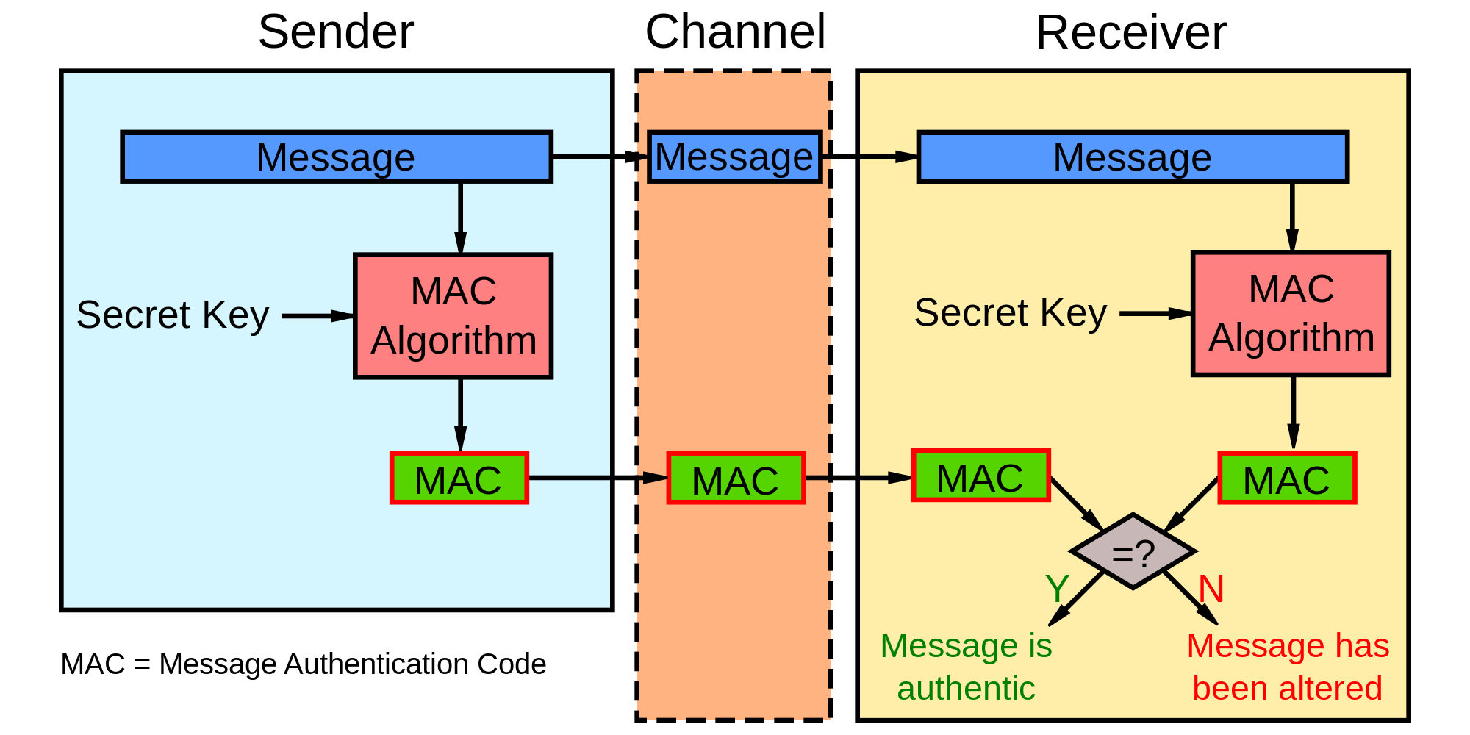
Revisit: MAC
Does the message authentication code guarantee data confidentiality?
How is the shared secret in the message authentication code distributed?

Slide 3
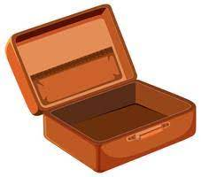





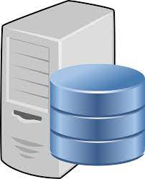


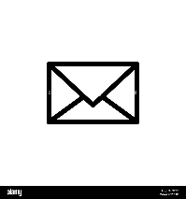

Goal: Authenticity
user
monitor
server
Notes:
小明（客户端）暗恋小红（服务端），想给小红写信，但是又怕信在邮递的过程中被人偷看，所以他把信装在一个盒子里锁起来，信虽然是安全了，但是小红就算收到了打不开啊，把钥匙给小红寄过去？万一钥匙也被人偷去了怎么办？
就在这时，小红想到了一个办法：小红把一个没有上锁的盒子寄给小明（钥匙在小红这），小明把钥匙放进去再锁上（小明可以锁盒子，但是一旦锁上了就连自己都打不开了），然后把这个装有钥匙的盒子寄回给小红，因为小红有钥匙，所以能打开盒子拿到里面的锁信件盒子的钥匙，再然后就能看到小明给她写的信了。同时，小红想回信的话，也可以把信装在这个盒子里寄回去，因为这是小明的盒子，他自己肯定还有一把锁，所以他也能打开，从此，小明和小红就可以任意的写信私通而不用担心其他人能看到了！
但是，如何保证小红寄送过来的未上锁盒子不被别人调包呢？这个等到我们介绍完HTTPS原理之后我们再回过头来看这个问题。

Slide 4

Goal: Authenticity
user
monitor
server

Slide 5
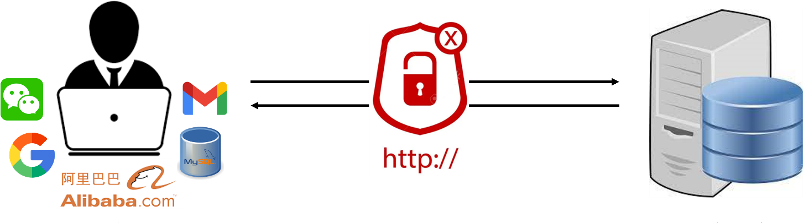
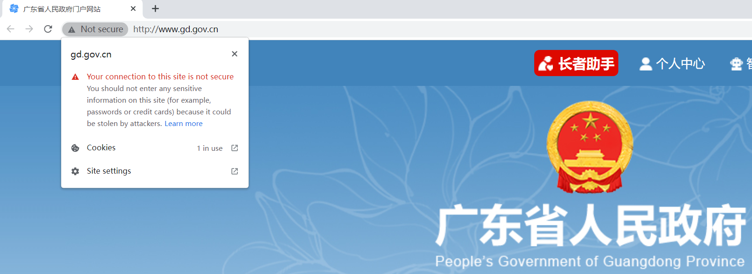
HTTP (Hyper Text Transfer Protocol over Secure Socket Layer)
Notes:
HTTPS全称Hyper Text Transfer Protocol over Secure Socket Layer，直译过来就是通过SSL实现的超文本传输协议，简单来讲就是加密版的HTTP协议，也就是HTTP+SSL/TLS。
HTTP协议：传输内容是明文，是没有加密的

Slide 6
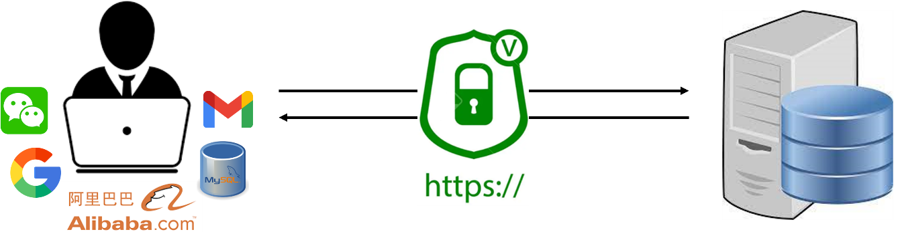

HTTP (Hyper Text Transfer Protocol over Secure Socket Layer)
HTTPS = HTTP + SSL/TLS
Notes:
为什么需要加密版的HTTP呢，因为我们都知道，HTTP是明文传输的，因此使用HTTP协议传输隐私信息非常不安全，很容易在传输过程中被窃取，或者通信内容被人篡改冒充，使用HTTPS可以避免这些问题。
实际上我们现在的HTTPS都是用的TLS协议，但是由于SSL出现的时间比较早，并且依旧被现在浏览器所支持，因此SSL依然是HTTPS的代名词。

Slide 7
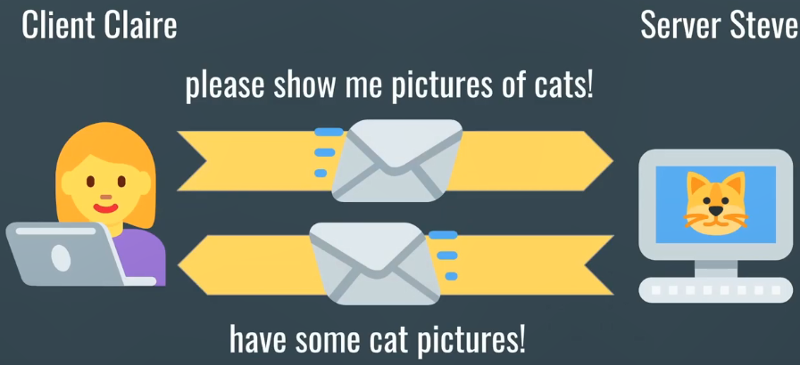
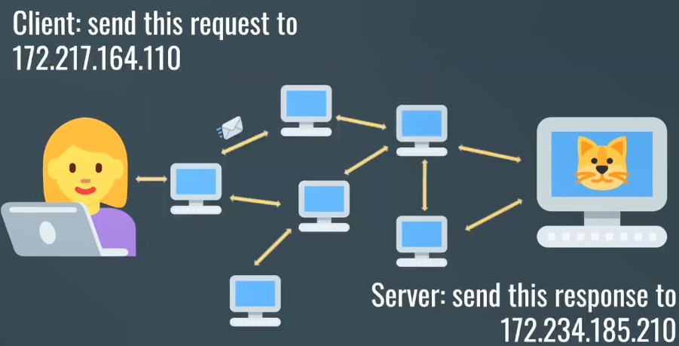
Notes:
Simplified model of how communication on the Internet works
A more realistic view

Slide 8
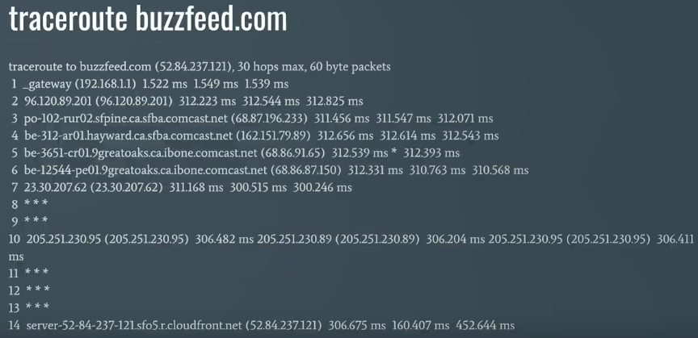
Notes:
Visualize this with the traceroute command

Slide 9
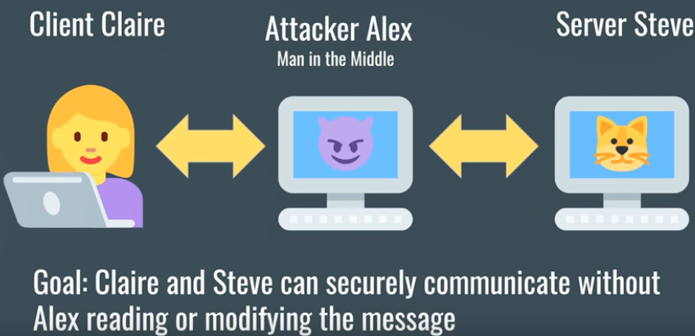
What does SSL/TSL provide?
Web Server
AT&T
A private conversation held in public

Slide 10
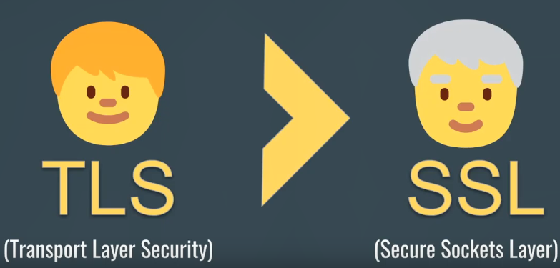
Web Server
Transport Layer Security (TLS) protocol
Based on Secure Sockets Layers (SSL) protocol
TLS is widely deployed security protocol
Deployed in nearly every web browser
https
Originally designed by Netscape in 1993
Provides
Confidentiality
Integrity
Authentication
AT&T
Notes:
SSL way actually predecessor to TLS
TLS uses stronger encryption algorithms and has the ability to work on different ports.
Netscape originally developed the SSL (Secure Sockets Layer) protocol to transmit information privately, ensure message integrity, and guarantee the server identity. SSL works mainly through using public/private key encryption on data. It is commonly used on web browsers, but SSL can also be used with email servers or any kind of client-server transaction. For example, some instant messaging servers use SSL to protect conversations.
The Internet Engineering Task Force (IETF) created TLS (Transport Layer Security) as the successor to SSL. It is most often used as a setting in email programs, but, like SSL, TLS can have a role in any client-server transaction.

Slide 11
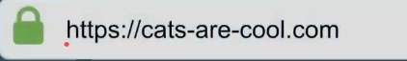
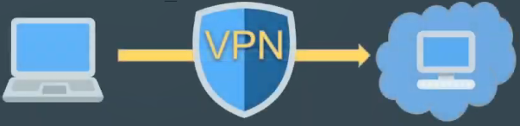
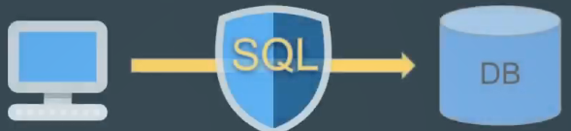
What is SSL/TLS?
Web Server
TLS
The TLS (Transport Layer Security) protocol provides communications security over the Internet.
AT&T
Notes:
Type a URL into your web browser that starts with HTTPS you are using the HTTP with TLS under, in order to encrypt that traffic.
Example: use a VPN server, SQL connection from a machine to a database.
This nice security building block.

Slide 12
What is TLS?
Web Server
TLS
The TLS (Transport Layer Security) protocol provides communications security over the Internet.
The protocol allows client/server applications to communicate in a way that is designed to prevent eavesdropping, tampering, or message forgery
AT&T

Slide 13
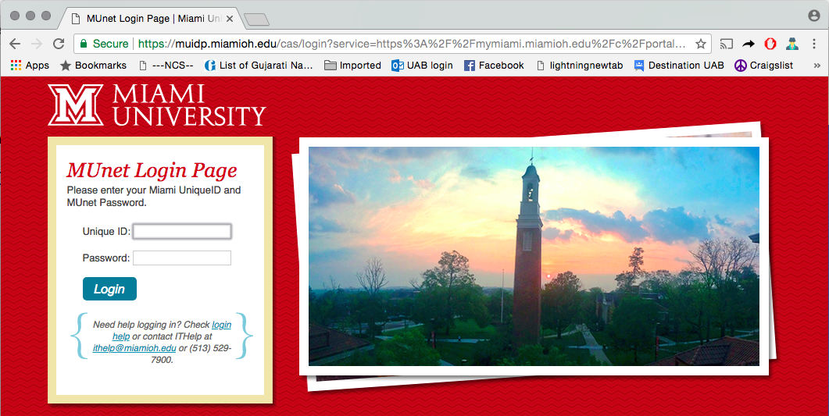
Notes:
You must have been to the webpages on the browser. Required to submit information like your password or credit card number.

Slide 14

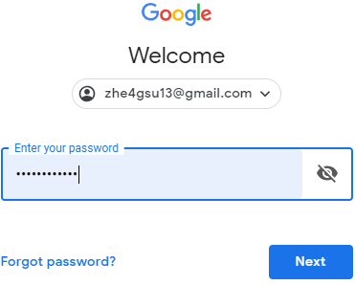
Web Server
insecure
Username: hez26
Password: mypassword123
AT&T
Username: hez26
Password: mypassword123
Notes:
Send my Email address and password to the Gmail web server. So it can authenticate my account.
However, the data that I sent to the Gmail server actually goes over the Internet which is kind of owned by different companies and parts.
The internet service provider that you use might be ATT, Verizon. So when you actually connect to the Internet, you are on your service providers Network.
So the data you send goes over the AT&T network to maybe a few other networks before it finally arrives at the mail server.
It is possible for a person in one of such companies who has proper access to the network.
It can be a lot of trouble for people if someone on the internet is able to capture it and misuse it.

Slide 15
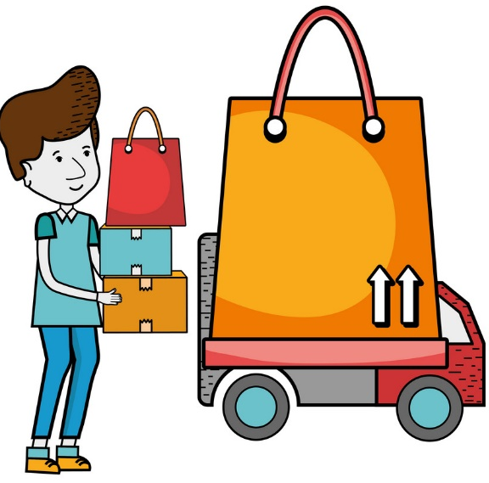
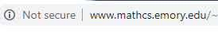
Web Server
insecure
AT&T
Http protocol
Notes:
Sending data over the Internet following the HTTP protocol is like sending some item through courier service without securing it in a lock box.
So a new protocol to handle secure data transfer was invented for handling valuable sensitive data.
This protocol is SSL

Slide 16
What is SSL?
Web Server
SSL: Secure Sockets Layers protocol
HTTPS = HTTP + SSL
SSL Handshake protocol
is basically used to establish trust and then negotiate what a secret key should be used to encrypt and decrypt the conversation
AT&T
Notes:
HTTP is nothing but HTTP protocol working in tandem with SSL that is HTTPs.
SSL takes care of making sure that data goes securely over the Internet

Slide 17

Cryptography
Web Server
“Something about Mary”
“4Sh!jH*=E#j@ns98$%=”
“same random string”
Encryption Algorithm
Decryption Algorithm
“4Sh!jH*=E#j@ns98$%=”
“Something about Mary”
Two problems: impractical, and distribute key
Notes:
But with millions of users on the Internet, it will be difficult and impractical to use one single key and share it amongst all these users.
How do we even send the secret key securely over the internet to these users.

Slide 18
Web Server
Web Server
Username: hez26
Password: mypassword123
4Sh!jH*=E#j@ns98$%=”
AT&T
Username: hez26
Password: mypassword123

Slide 19
SSL Handshake protocol is basically used to establish trust and then negotiate what a secret key should be used to encrypt and decrypt the conversation

Slide 20
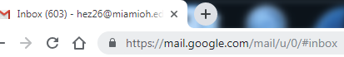
SSL handshake:
Step 1: the server responds with a “ServerHello” message
Web Server
Web Server
443
TCP connection
CLIENT HELLO
Highest SSL Version: 2.0
Ciphers: SHA1, SHA1-DES
Compression: gzip
AT&T
Notes:
When a user clicks on HTTPs link or types in HTTPS URL in the browser and hits enter.
The first thing that the browser does is to make a TCP connection on the HTTP port 443. Actually, 443 is the default port on which the server listens for HTTPs connections.
After the connection is successful, the process of what is called SSL handshake starts.
For this handshake, first the browser sends a message called Client Hello.
SSL version that the browser supports
Suit of ciphers it can use for encryption
It also generates some random data that will be later used when generating symmetric key for the session.

Slide 21
SSL handshake:
Step 2: the client sends a “ClientHello” message
Web Server
Web Server
SERVER HELLO
SSL Version: 2.0
Ciphers: SHA1
Compression: gzip
SessionID: heff9
443
AT&T
Notes:
Then the server responds with what is called the server hello message which includes the SSL version that will be used for the session.
The server also generates some random data and sends it. This data will also be used in the key generation process.

Slide 22
SSL handshake:
Step 3: the server sends a “Digital Certificate” message
Web Server
Web Server
Certificate
Public Key: yd77sd8
Issued to: www.google.com
Issued by: Thawte SGC CA
Valid From: 04-23-2019
Valid To: 05-23-2020
443
AT&T
Notes:
After the server hello message, the server sends the browser its digital certificate which is digitally signed by assigned authority
Two purposes: first it contains the public key of the server so that the browser can use this key to encrypt the data that it sends to the server; The second purpose is that it establishes the identify of the server from which the webpage is coming.
You want to be sure that the page displayed on the browser has indeed come from the website you wanted to go to because you want to be sure that any data you send through this web page actually goes to the right server.

Slide 23
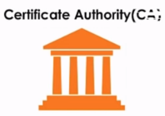

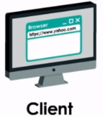
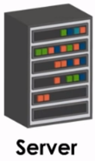
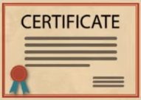
SSL handshake:
Step 4: The client will contact the server’s CA (Certification Authority)
Web Server
Web Server
Notes:
Verifies the server’s digital certificate. Thus conforming the authenticity of the web server.

Slide 24
SSL handshake:
Step 5: The server’s CA returns results to the client
Web Server
Web Server
Notes:
Verifies the server’s digital certificate. Thus conforming the authenticity of the web server.
Step 4 is basically establishing trust on the web server.

Slide 25

SSL handshake:
Step 6: ClientKeyExchange
Web Server
Web Server
443
Symmetric Secret Key:
fsdklbhnslsshnfsw;lfjslvs;lvjsvl;snv
A shared secret key encrypted with the server’s public key
AT&T
Notes:
The browser can generate a symmetric secret key just to be used for this SSL session.
After generating the secret session key, it will encrypt it using the public key sent by the server and send across to the server.
Symmetric is computationally lighter

Slide 26
SSL handshake:
Step 6: The client sends a “finished” message
Web Server
Web Server
443
Finished
AT&T
Notes:
SSL session is terminated.
The finish message is encrypted with the shard secret key. Handshake complete.

Slide 27
SSL handshake:
Step 7: The server sends a “finished” message
Web Server
Web Server
Finished
443
AT&T
Notes:
SSL session is terminated.
The finish message is encrypted with the shard secret key. Handshake complete.

Slide 28
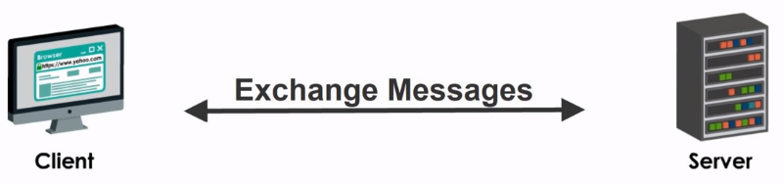
SSL handshake:
Step 8: Exchange messages with the shared secret key
AT&T

Slide 29
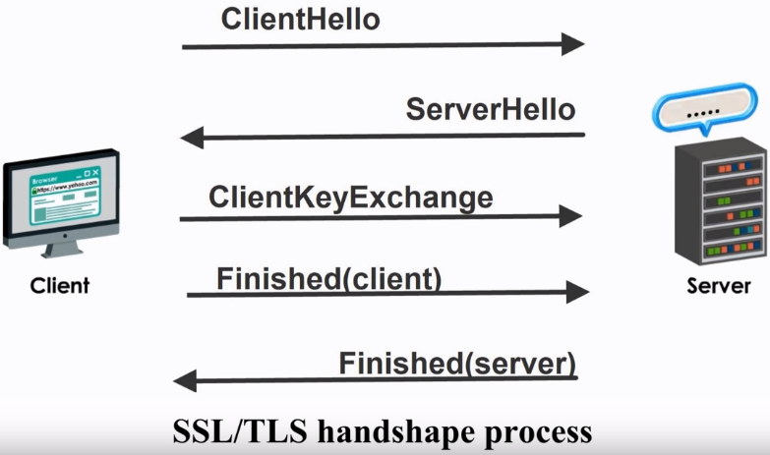
AT&T

Slide 30
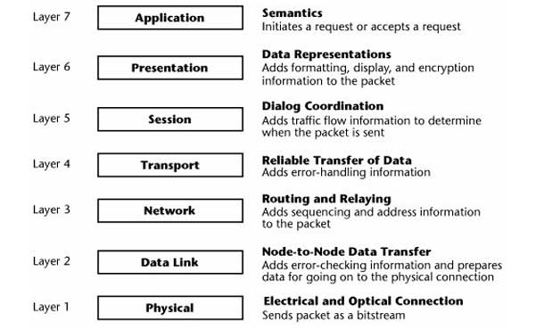
Web Server
Web Server
AT&T
What layer does the SSL protocol operate?
Notes:
Application layer? because it is just http over SSL
Presentation layer? because encryption and decryption operate on this layer
Session layer? because the protocol provides point-to-point security.
If we use TCP/IP model, we can simply say the protocol belongs to application layer.

